Slide 1

Test Strategy:
JustDial Car Wash Services
Authored by Auto Mates

Slide 2
Introduction: Purpose & Audience
Purpose
Target Audience
Outlines testing types, levels, and methodology to validate all key system features, new and existing. Sets boundaries for test activities and aids early issue identification.
Business Unit (BU) SME
Academy Coach
Technical Trainer

Slide 3
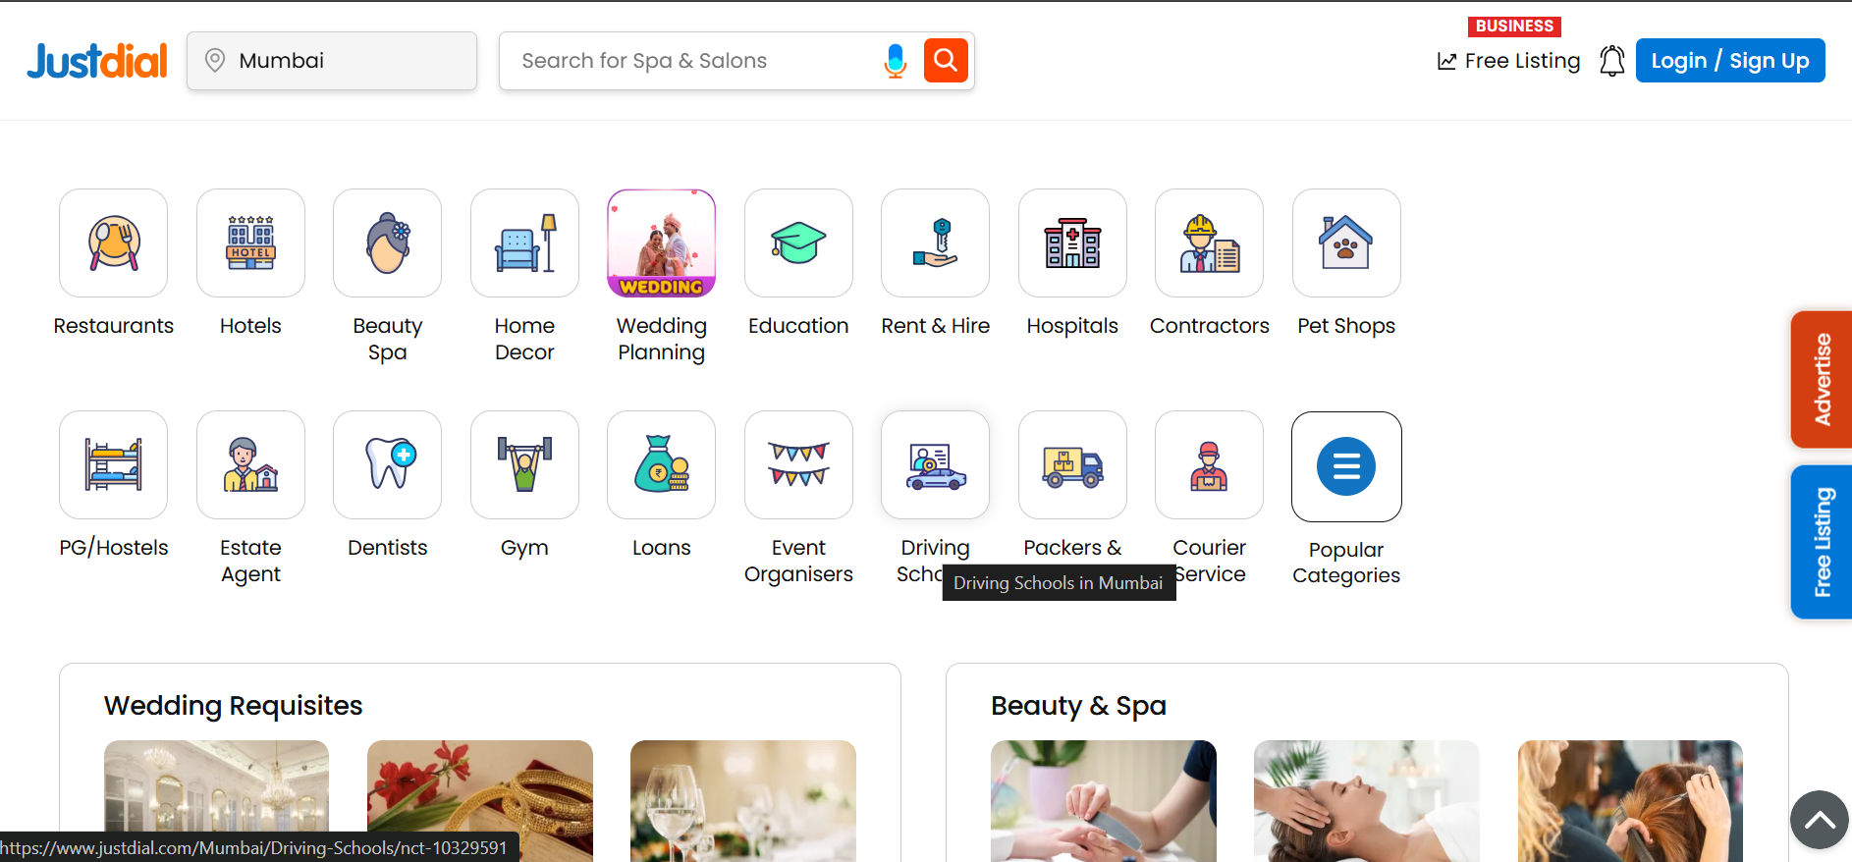
System Description: Justdial.com
Justdial.com is a comprehensive local search engine in India, offering discovery of businesses, services, and professionals. Features include location-based search, ratings/reviews, interactive UI elements, service booking, and free listings.
It's a rich candidate for functional UI automation using Selenium.

Slide 4
Automation Challenges & Opportunities
Limitations
User login/signup via OTP cannot be automated due to security. Dynamic content, third-party widgets, and real-time data integrations pose stability challenges.
Automated Areas
Many functional areas like search workflows, form validations, and menu discovery can be automated using Selenium, TestNG, Apache POI, and Cucumber.

Slide 5
Test Deliverables by Project Phase
Project Phase
Deliverables
Test Planning
Test Strategy Document
Test Analysis & Design
Test Conditions, Test Cases, Test Data, Test Environment, Automated Test Scripts
Test Execution
Test Logs
Test Completion
Test Summary Report

Slide 6
Key Test Types
Functional Testing
Manual Testing
Verifying that all features work as specified.
Human-driven testing for exploratory and complex scenarios.
Automation Testing
Smoke Testing
Automated scripts for repetitive and regression tests.
Quick tests to ensure critical functionalities are working.

Slide 7

Multi-Browser Testing
To ensure application functionality across different environments, testing is conducted on two primary browsers:
Chrome
Edge
Firefox
This confirms consistent user experience and performance.

Slide 8




Test Data Management
Excel Files
XML & JSON
Primary source for test data, stored in structured sheets.
Additional formats for runtime data provision.
Data-Driven Library
Property Files
Created using Apache POI for efficient data handling.
Used for storing sensitive information like URL, Browser, Username, and Password.

Slide 9

Required Resources: Hardware
PC
Standard personal computers are required for all testing activities, ensuring adequate processing power and memory for test execution.

Slide 10






Required Resources: Software
Windows OS
Chrome
Windows 7 and above.
Version 60 and above.
MS Excel
Selenium
For test data management.
Web drivers & Grid.
BDD Cucumber
Jenkins
For behavior-driven development.
For continuous integration.
Apache POI
TestNG
For data handling.
For test execution framework.

Slide 11


